Slide 1

CSS Styles and Selectors

Slide 2
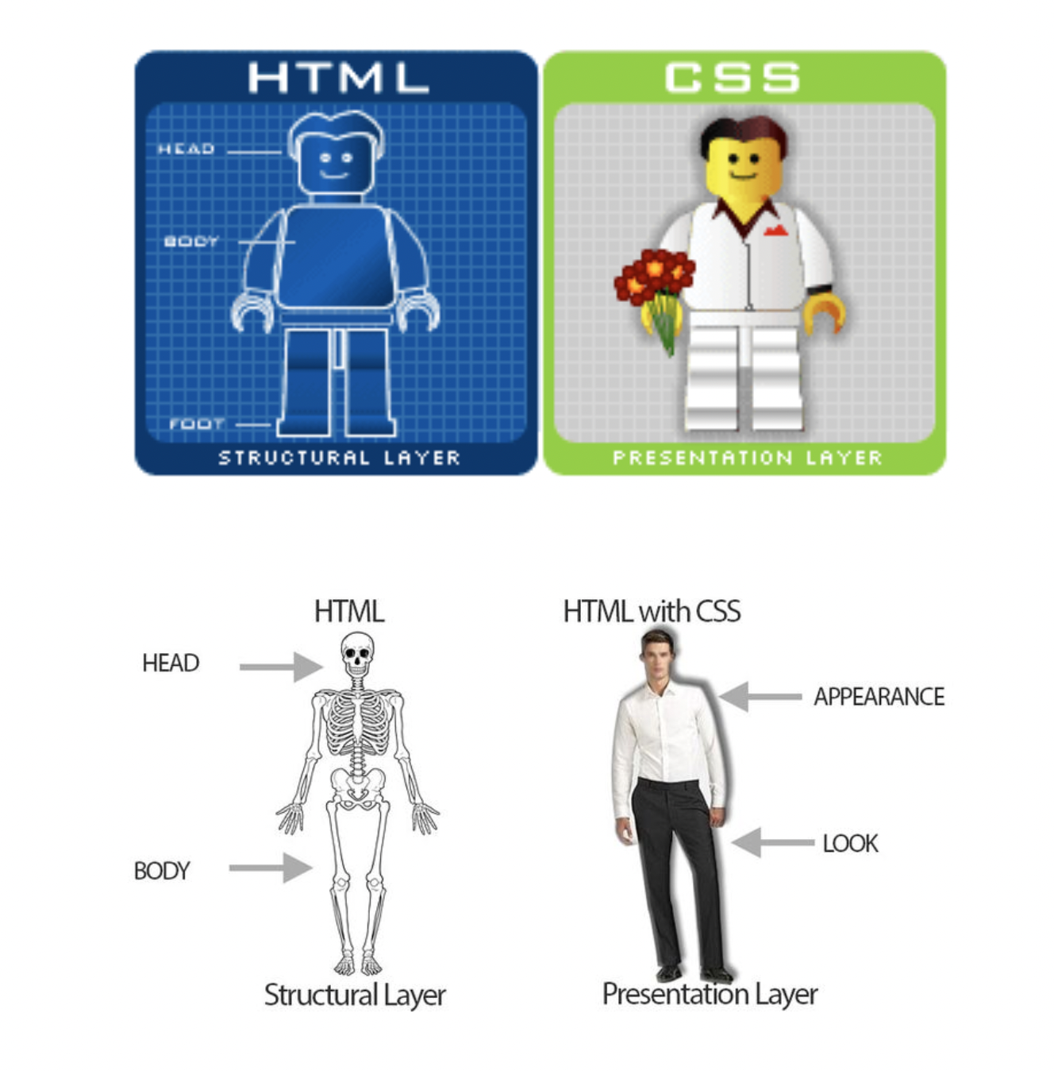
HTML VS CSS

Slide 3
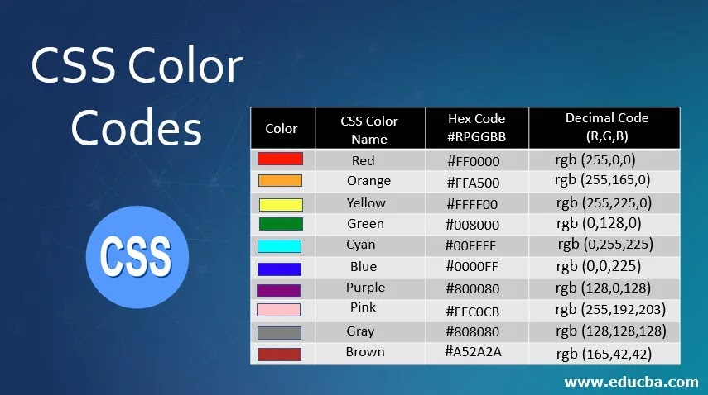
CSS Hex Colors

Slide 4
Different CSS Properties
CSS Color
- CSS Color Keywords
- CSS RGB Colors
- CSS HEX Colors
CSS Font-size
Text-align (left, right, centre, justify)

Slide 5
Selectors
Types of Selectors
There are various types of selectors in CSS. They are:
CSS Element / tag Selector
CSS Id Selector
CSS Class Selector
CSS Universal Selector

Slide 6
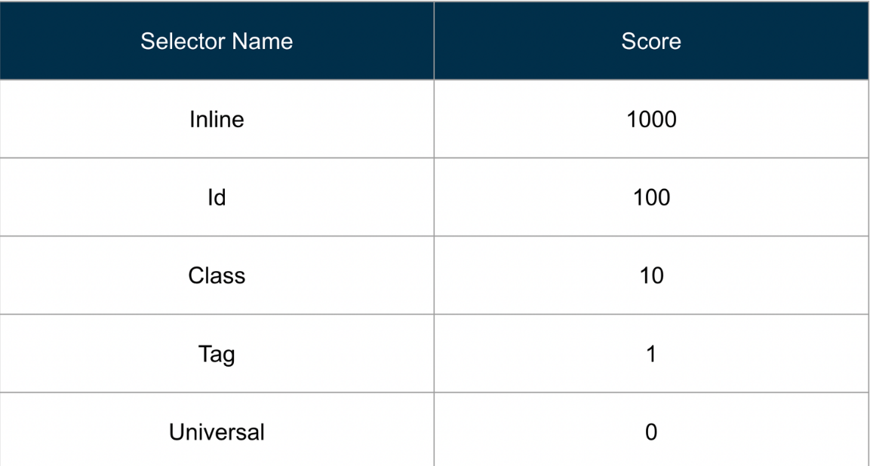
Scores of various selectors

Slide 7
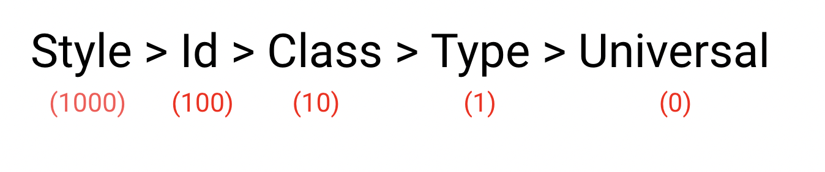
Priority of Selectors

Slide 8
Specificity in CSS
Follow this order SICTU
S - inline style
I - Id selector
C - Class selector
T - Type/Tag selector
U - Universal selector

